Slide 1
ReactJS - Router

Slide 2
Install a React Router
A simple way to install the react-router is to run the following code snippet in the command prompt window.
npm install react-router

Slide 3
Routing is a process in which a user is directed to different pages based on their action or request.
ReactJS Router is mainly used for developing Single Page Web Applications. React Router is used to define multiple routes in the application.
When a user types a specific URL into the browser, and if this URL path matches any 'route' inside the router file, the user will be redirected to that particular route.

Slide 4
React Router is a standard library system built on top of the React and used to create routing in the React application using React Router Package.
It provides the synchronous URL on the browser with data that will be displayed on the web page.
It maintains the standard structure and behavior of the application and mainly used for developing single page web applications.

Slide 5
Need of React Router
React Router plays an important role to display multiple views in a single page application.
Without React Router, it is not possible to display multiple views in React applications.
Most of the social media websites like Facebook, Instagram uses React Router for rendering multiple views.

Slide 6
React Router Installation
React contains three different packages for routing. These are:
react-router: It provides the core routing components and functions for the React Router applications.
react-router-native: It is used for mobile applications.
react-router-dom: It is used for web applications design.
It is not possible to install react-router directly in your application. To use react routing, first, you need to install react-router-dom modules in your application. The below command is used to install react router dom.

Slide 7
react-router-dom package
ReactJS is a free and open source front-end library used for building single page applications.
react-router-dom: react-router-dom is a reactJS package, It enables you to implement dynamic routing in a web page.
Approach:
Create basic react app.
Make different pages for routing.
Install react-router-dom package.
Implement routing using react-router-dom package.
$ npm install react-router-dom --save

Slide 8
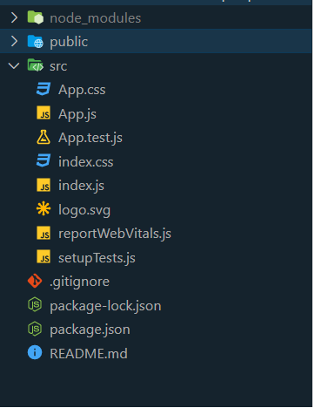
Step 1:
Create a basic react app using the following command in your terminal.
npx create-react-app <project_name>
Project Structure: After creating the basic react app, the folder structure looks like this,

Slide 9
Step 2
Make different pages for routing. Here, We are going to create different components for our react-app. So that we route over them for demonstration.
Components: Home Page, About Page, ContactUs Page.
After creating components, the Folder structure looks like this,

Slide 10
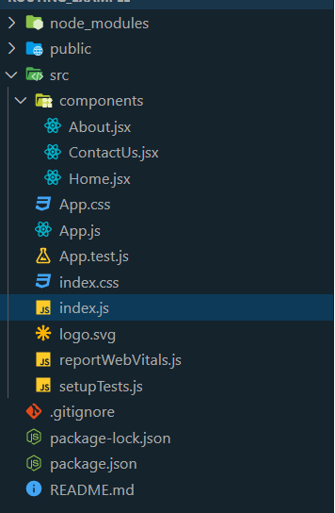
Cont…

Slide 11
Example 1
Step-1: In our project, we will create three more components along with App.js, which is already present.
About.js
import React from 'react'
class About extends React.Component {
render() {
return <h1>About</h1>
}
}
export default About
Contact.js
import React from 'react'
class Contact extends React.Component {
render() {
return <h1>Contact</h1>
}
}
export default Contact

Slide 12
Step 3:
Install react-router-dom package.
We are going to install the react-router-dom package in our react-app, using the following command.
npm i react-router-dom

Slide 13
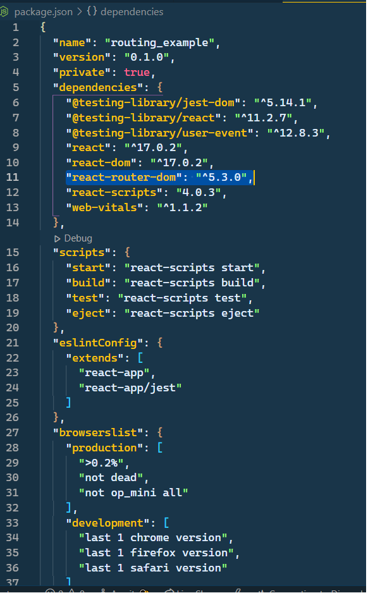
Cont…
After installing react-router-dom package package.json file looks like this,

Slide 14
Cont.
App.js
import React from 'react'
class App extends React.Component {
render() {
return (
<div>
<h1>Home</h1>
</div>
)
}
}
export default App

Slide 15
Cont..
For Routing, open the index.js file and import all the three component files in it. Here, you need to import line: import { Route, Link, BrowserRouter as Router } from 'react-router-dom' which helps us to implement the Routing. Now, our index.js file looks like below.
What is Route?
It is used to define and render component based on the specified path. It will accept components and render to define what should be rendered.

Slide 16
Index.js
const routing = (
<Router>
<div>
<h1>React Router Example</h1>
<Route path="/" component={App} />
<Route path="/about" component={About} />
<Route path="/contact" component={Contact} />
</div>
</Router>
)
ReactDOM.render(routing, document.getElementById('root'));
import React from 'react';
import ReactDOM from 'react-dom';
import { Route, Link, BrowserRouter as Router } from 'react-router-dom'
import './index.css';
import App from './App';
import About from './about'
import Contact from './contact'

Slide 17
Create Components
we will create four components.
The App component will be used as a tab menu.
The other three components (Home), (About) and (Contact) are rendered once the route has changed.

Slide 18
Example 2 (How to redirect to another page in ReactJS ? )
Step 2.1.Home. Jsx
import React from "react";
const Home = () => {
return (
<div>
<h1>Home Page</h1>
</div>
);
};
export default Home;

Slide 19
2. About.JSx
import React from "react";
const About = () => {
return (
<div>
<h1>About Page</h1>
</div>
);
};
export default About;

Slide 20
ContactUs.Jsx
import React from "react";
const ContactUs = () => {
return (
<div>
<h1>Contact Us Page</h1>
</div>
);
};
export default ContactUs;

Slide 21
Step 3
npm i react-router-dom
Implement routing using the react-router-dom package.
We are going to implement the react-router-dom package in our react-app.
We have to import some components from the react-router-dom package i.e. BrowserRouter, Switch, Route, and Redirect.

Slide 22
import { BrowserRouter as Router, Switch, Route, Redirect,} from "react-router-dom";
BrowserRouter: It uses the HTML5 history API to keep the UI in sync with the URL.
Route: Its responsibility is to render UI, when its path matches the current URL.
Switch: It renders the first child Route or Redirect that matches the location.
Redirect: It renders the new location irrespective of the current location in history stack.

Slide 23
App.js
import "./App.css";
// importing components from react-router-dom package
import {
BrowserRouter as Router,
Switch,
Route,
Redirect,
} from "react-router-dom";

Slide 24
Step 4. Home.jsx
After implementing routing in App.js file, We have to give the routing end points at user side. So, We are going to give the routing endpoints in Home.jsx file.
Here is the updated Home.jsx file.
Then npm start

Slide 25
Components in React Router
There are two types of router components:
<BrowserRouter>: It is used for handling the dynamic URL.
A <Router> that uses the HTML5 history API (pushState, replaceState and the popstate event) to keep your UI in sync with the URL.
<HashRouter>: It is used for handling the static request.
A <Router> that uses the hash portion of the URL (i.e. window.location.hash) to keep your UI in sync with the URL.

Slide 26
<BrowserRouter>
<BrowserRouter
basename={optionalString}
forceRefresh={optionalBool}
getUserConfirmation={optionalFunc}
keyLength={optionalNumber}
>
<App />
</BrowserRouter>

Slide 27
basename: string
The base URL for all locations. If your app is served from a sub-directory on your server.
A properly formatted basename should have a leading slash, but no trailing slash.
<BrowserRouter basename="/calendar">
<Link to="/today"/> // renders <a href="/calendar/today">
<Link to="/tomorrow"/> // renders <a href="/calendar/tomorrow"> ...
</BrowserRouter>

Slide 28
getUserConfirmation: func
A function to use to confirm navigation. Defaults to using window.confirm.
<BrowserRouter
getUserConfirmation={(message, callback) => {
// this is the default behavior const allowTransition = window.confirm(message);
callback(allowTransition);
}}
/>

Slide 29
forceRefresh: bool
If true the router will use full page refreshes on page navigation.
To use this to imitate the way a traditional server-rendered app would work with full page refreshes between page navigation.
<BrowserRouter forceRefresh={true} />
keyLength: number
The length of location.key. Defaults to 6.
BrowserRouter keyLength={12} />

Slide 30
<HashRouter>
It is used for handling the static request.
A <Router> that uses the hash portion of the URL (i.e. window.location.hash) to keep your UI in sync with the URL.
<HashRouter
basename={optionalString}
getUserConfirmation={optionalFunc}
hashType={optionalString}
>
<App />
</HashRouter>

Slide 31
basename: string
The base URL for all locations. A properly formatted basename should have a leading slash, but no trailing slash.
<HashRouter basename="/calendar"/>
<Link to="/today"/> // renders <a href="#/calendar/today">

Slide 32
getUserConfirmation: func
A function to use to confirm navigation. Defaults to using window.confirm
<HashRouter
getUserConfirmation={(message, callback) => {
// this is the default behavior
const allowTransition = window.confirm(message); callback(allowTransition);
}}
/>

Slide 33
<Link>
Provides declarative, accessible navigation around your application.
<Link to="/about">About</Link>
to: string
A string representation of the Link location, created by concatenating the location’s pathname, search, and hash properties.
<Link to="/courses?sort=name" />

Slide 34
to: object
An object that can have any of the following properties:
pathname: A string representing the path to link to.
search: A string representation of query parameters.
hash: A hash to put in the URL, e.g. #a-hash.
state: State to persist to the location.
<Link
to={{
pathname: "/courses",
search: "?sort=name",
hash: "#the-hash",
state: { fromDashboard: true }
}}
/>

Slide 35
to: func
A function to which current location is passed as an argument and which should return location representation as a string or as an object
<Link to={location => ({ ...location, pathname: "/courses" })} />
<Link to={location => `${location.pathname}?sort=name`} />
replace: bool
When true, clicking the link will replace the current entry in the history stack instead of adding a new one.
<Link to="/courses" replace />

Slide 36
<NavLink>
A special version of the <Link> that will add styling attributes to the rendered element when it matches the current URL.
<NavLink to="/about">About</NavLink>
className: string | func
activeClassName: string
style: object | func

Slide 37
className: string | func
className can either be a string or a function that returns a string.
If the function className is used, the link’s active state is passed as a parameter.
To exclusively apply a className to an inactive link.
<NavLink
to="/faq"
className={isActive =>
"nav-link" + (!isActive ? " unselected" : "")
} >
FAQs
</NavLink>

Slide 38
activeClassName: string
The class to give the element when it is active. The default given class is active. This will be joined with the className prop.
<NavLink to="/faq" activeClassName="selected">
FAQs
</NavLink>

Slide 39
style: object | func
style can either be a React.CSSProperties object or a function that returns a style object.
If the function style is used, the link’s active state is passed as a parameter.
<NavLink
to="/faq"
style={isActive => ({ color: isActive ? "green" : "blue“
})}
> FAQs
</NavLink>

